Slide 1
Predicting Client Subscription in Bank Marketing Campaigns
A Machine Learning Approach

Slide 2
TABLE OF CONTENTS
01
02
03
PROBLEM STATEMENT
ANALYSIS & MODELING
BUSINESS INSIGHTS & CONCLUSION
Predict if the client will subscribe to a term deposit
Exploratory Data Analysis and Model Development
Business Use Cases and Recommendations

Slide 3
PROBLEM STATEMENT
01
Predict if the client will subscribe to a term deposit

Slide 4
Problem Statement
Dataset consists of 41, 200 rows and 21 columns.
Key attributes entail client demographics, campaign details, and economic indicators.
Target variable (y - subscription status).

Slide 5
ANALYSIS & MODELING
02
Exploratory Data Analysis and Model Development

Slide 6
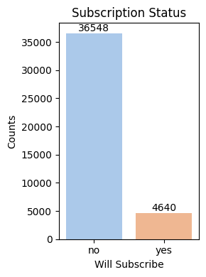
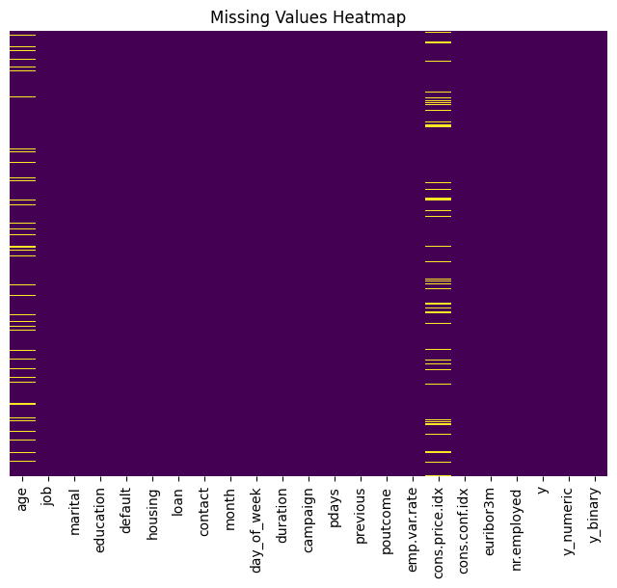
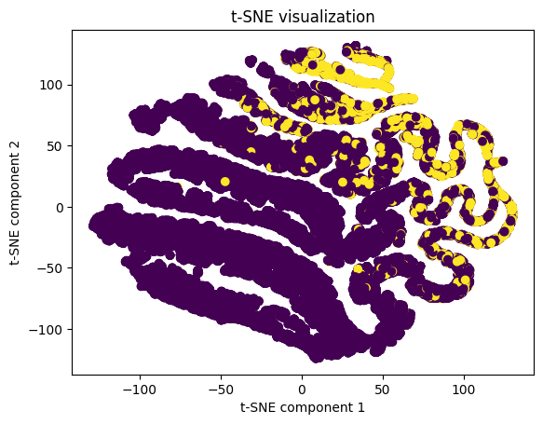

Slide 7
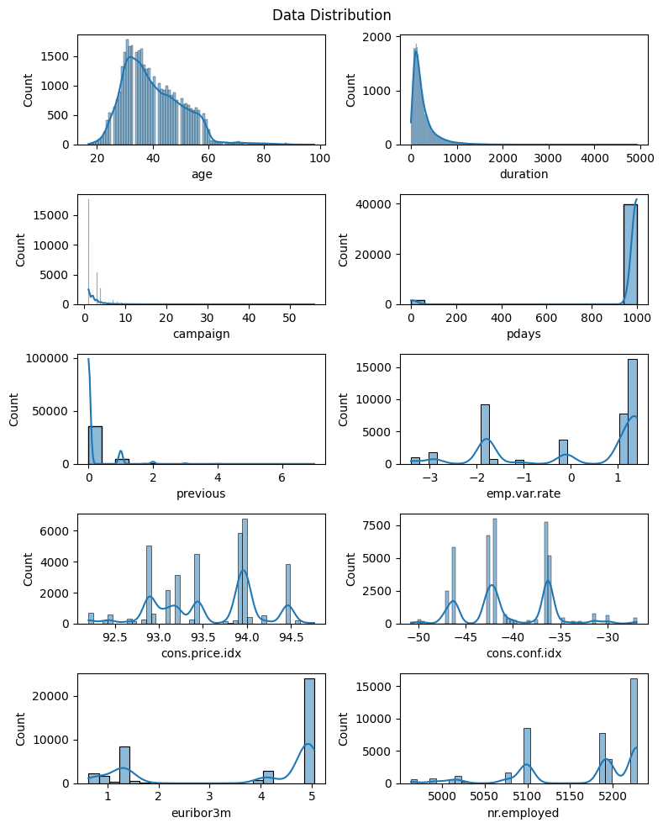
No Numerical Feature has a Gaussian Distribution.

Slide 8
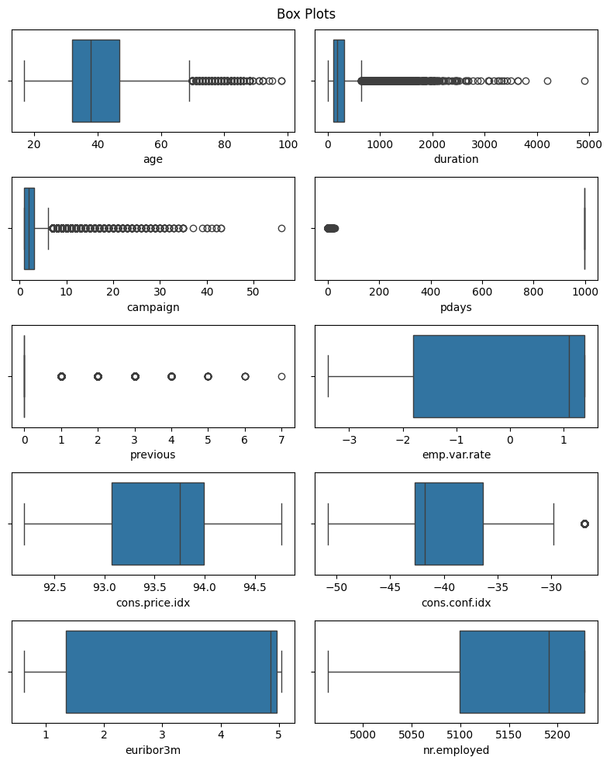
Features with outliers are mostly from campaign data.

Slide 9
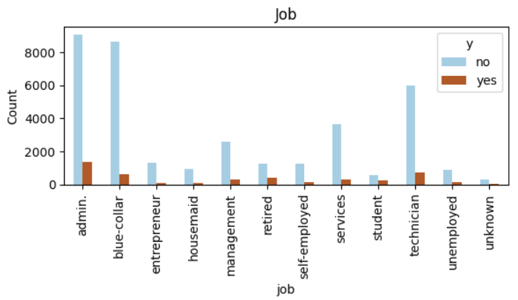
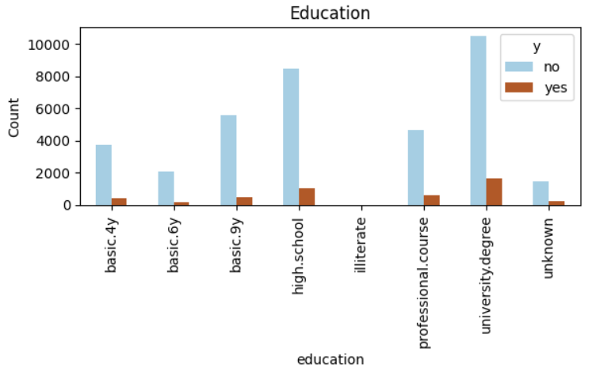
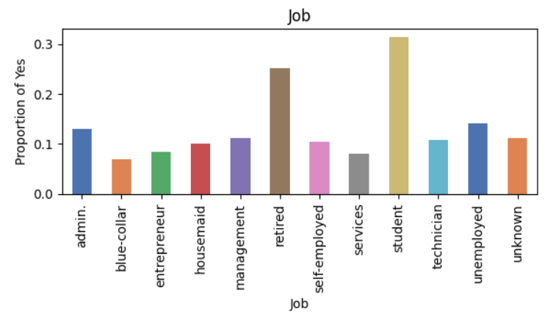
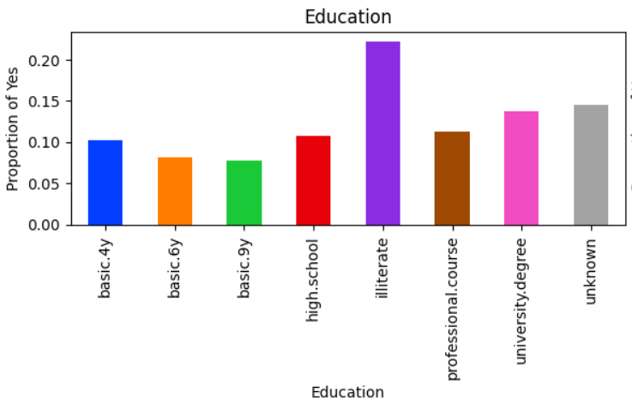
Client Demographic Features

Slide 10
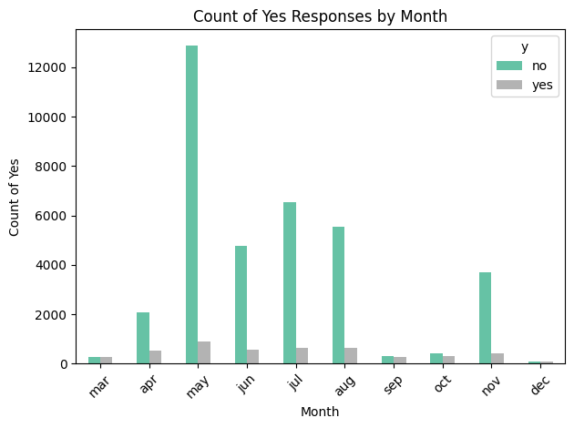
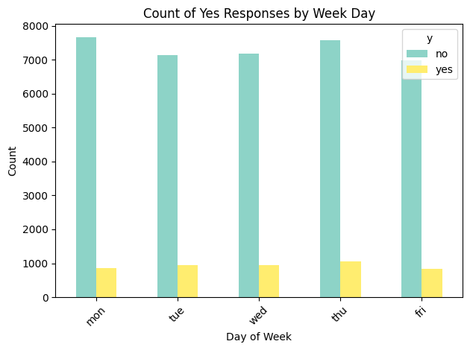
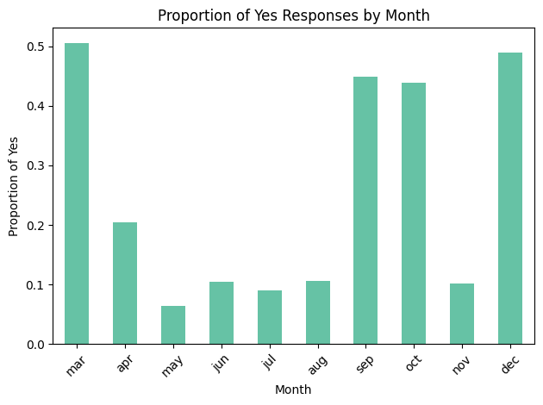
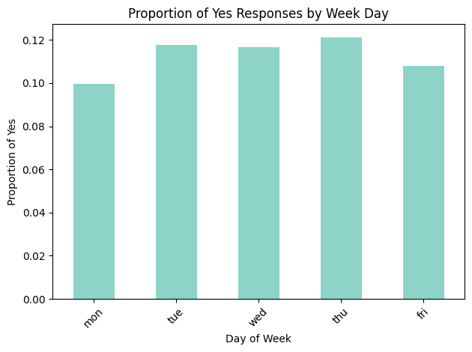
Temporal Features

Slide 11
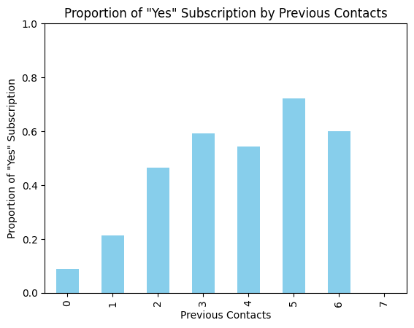
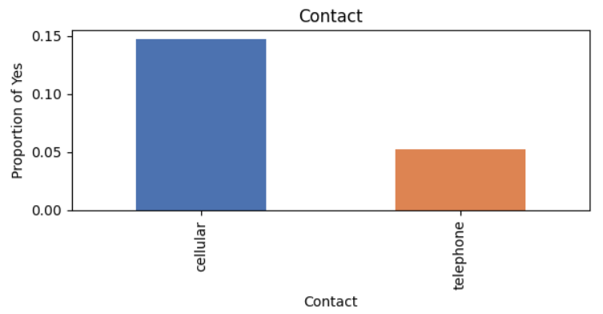
Marketing Campaign Attributes
The probability of subscribing to Term Deposit increases with number of previous contacts.

Slide 12
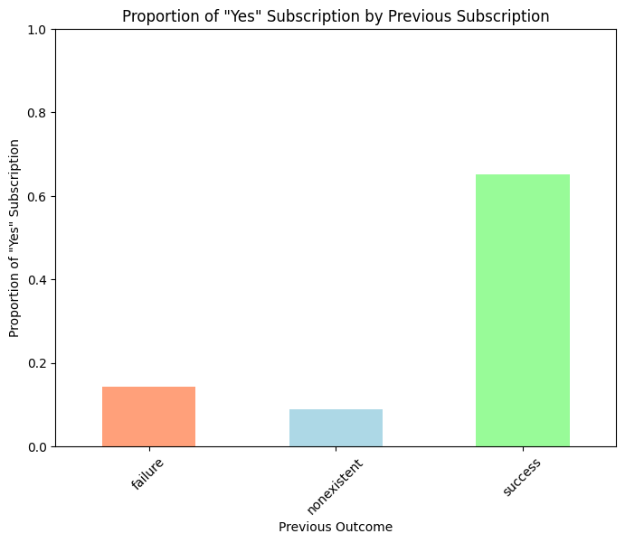
Marketing Campaign Attributes
Approximately 65% of clients who subscribed previously agreed to do it again.

Slide 13
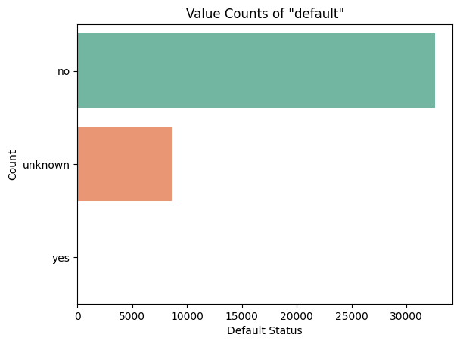
Socio-Economic Attributes
Only 3 People responded with ‘yes’, hence this features isn’t useful for prediction.

Slide 14
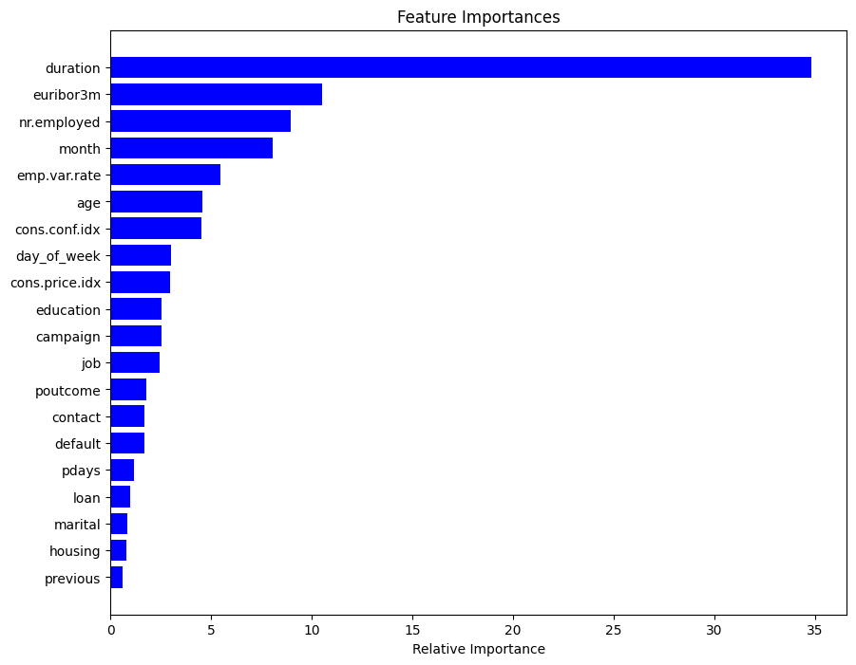
Feature Importance

Slide 15
FEATURE ENGINEERING:
‘Loan' and 'housing' features are insignificantly associated with the target variable, thus offering no predictive value.
Binning of ‘Age’ is performed.
‘Duration’ feature is dropped as it’s an information post prediction.
‘Default’ feature is dropped as it does not provide value.
Clustered attributes, found strong correlations in all clusters with target variable, indicating good predictive value.

Slide 16
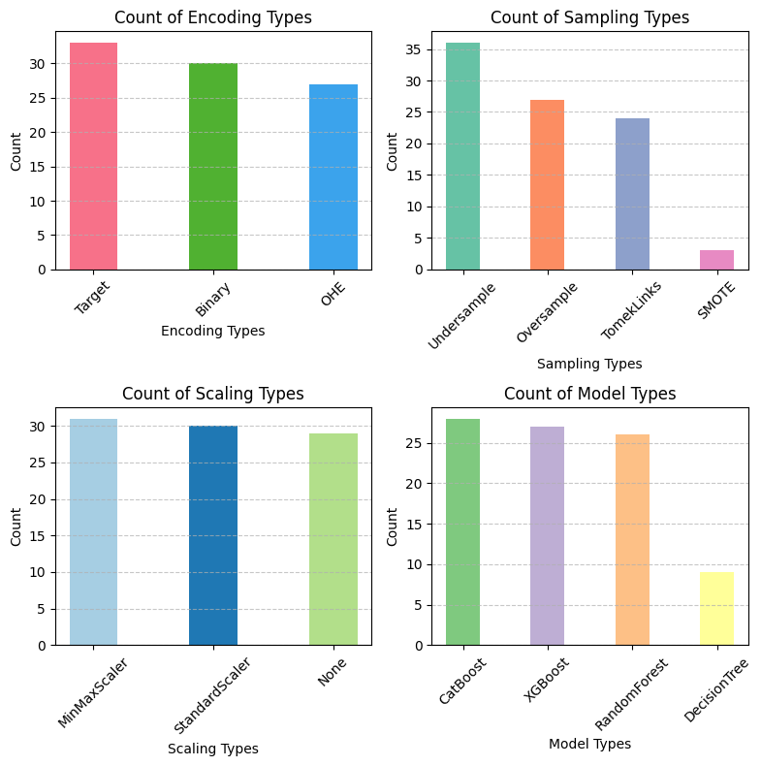
Balanced accuracy and F Beta score (beta=2) share the same insights.

Slide 17
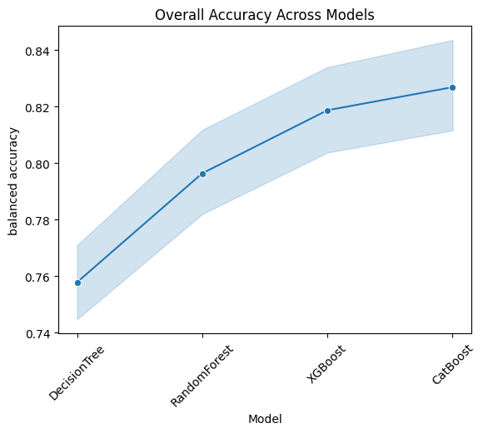
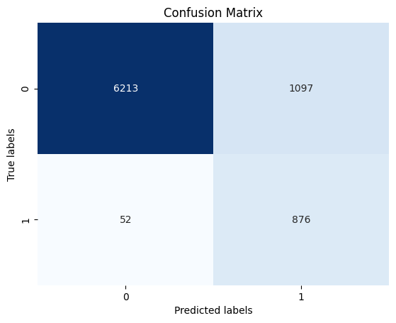
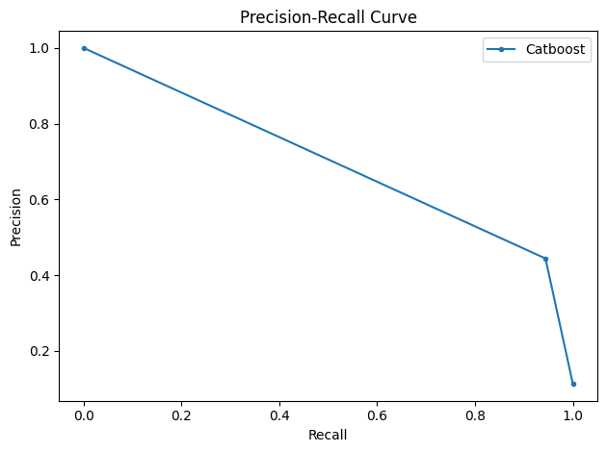

Slide 18
Business Insights & Conclusion
03
Business Use Cases and Recommendations

Slide 19
RECOMMENDATIONS
DATA ANALYSIS
Contact people irrespective of campaign’s success.
Contact a client multiple times.
Contact previously subscribed clients.
Contact client in higher age bracket and higher education.
Mode of contact should be cellphone.
MODEL DEVELOPMENT
Best params: Target Encoding, Undersampling, Min Max Scaler and Catboost.

